Slide 1

NAME OF THE PROJECT:
A Project Report on:
“Cause of Death”
Submitted by:
A KISHORE KUMAR
Batch No.:
Internship_33
Notes:
Sumitted by- Kashish Mudgil
Internship-ww

Slide 2
Introduction
Death is a natural part of life but dying prematurely, especially due to unfortunate and unnecessary causes, is something we as individuals and as a society should seek to avoid.
A straightforward way to assess the health status of a population is to focus on mortality – or concepts like child mortality or life expectancy, which are based on mortality estimates.
A focus on mortality, however, does not take into account that the burden of diseases is not only that they kill people, but that they cause suffering to people who live with them.
An important first-step in decreasing death tolls is examining the causes of death that affect humans on a global scale.
The dataset chosen to use for this project aims to assist in the effort of analysing causes of death on a global scale.
In this Dataset, we have Historical Data of different cause of deaths for all ages around the World.

Slide 3
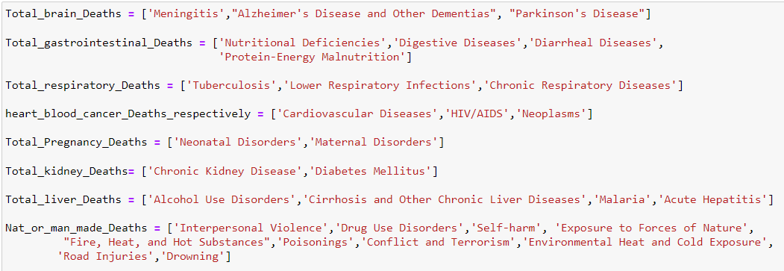
The key features of this Dataset after Segregating the Cause of deaths are :

Slide 4

Hardware & Software Used:
Hardware Used -
Processor: AMD Ryzen 5.
RAM: 8 GB.
GPU: AMD Radeon(TM) Vega 8.
Software Used -
Anaconda: Jupyter Notebook
Different libraries are used while building ML model and Visualisation of data.

Slide 5
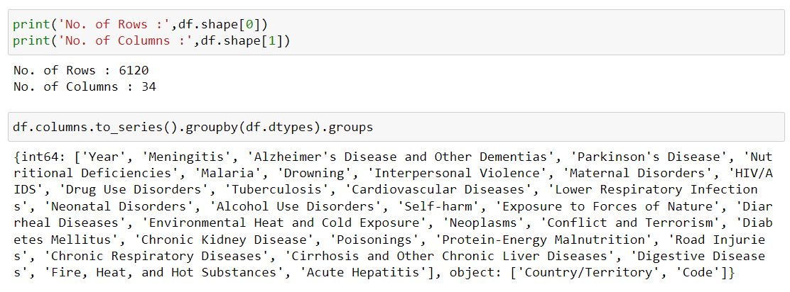
Data Sources and their size:
Observations:
We have 6120 Rows and 34 Columns in this Dataset.
We have 32 Numerical dtype Columns and 02 Object dtype columns.
So, far we don't have any null values in any of the columns of the dataset.
We may drop either 'Country/Territory' or 'Code' Column, as they boths gives the same info.
Object data type columns need to be converted to numerical data.

Slide 6

Data Intigrity Check
Before pre-processing data, integrity of data is to be checked.
Dataset may contain whitespaces, missing value etc. let's investigate the integrity of data before proceeding for further analysis.
Observations:
Dataset do not contain whitespaces, missing value, 'None','-999','0',' ','?','-',' ?','null' ,'NA', 'N/A'.
Dataset don't have any duplicate values in it.

Slide 7
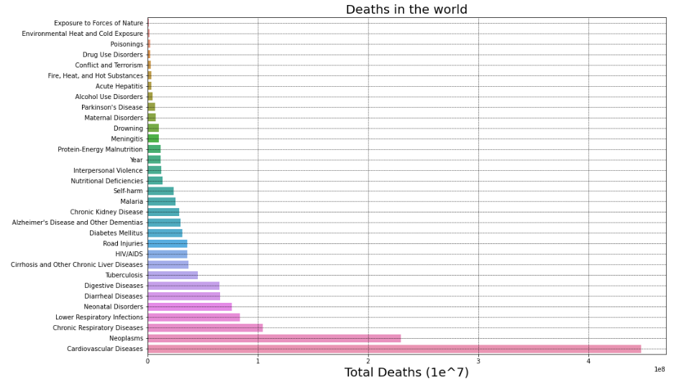
Exploratory Data Analysis (E.D.A):
Observation:
It is obvious that cardiovascular disease dominates death toll all over the world.

Slide 8
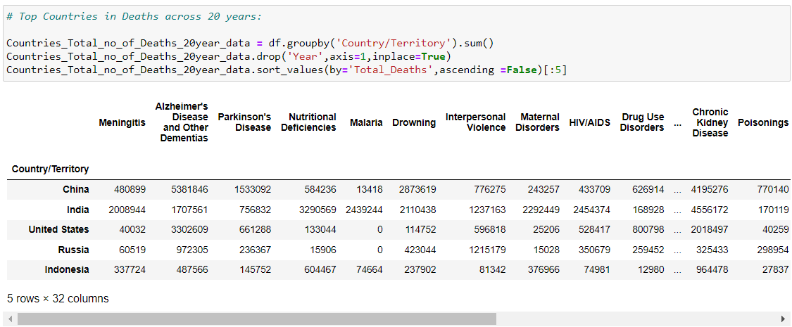
Observation:
From the above table, we can see a mixture of developed and developing countries with a sizeable population.
So, by doing ample EDA & Statistical analysis of these top 5 countries we can get the affect of each disease with respect to the rest of countries.

Slide 9
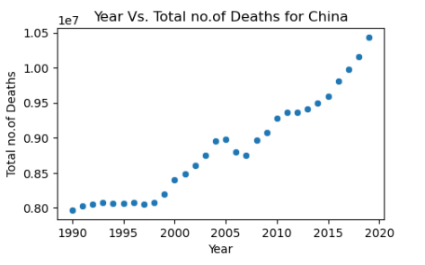
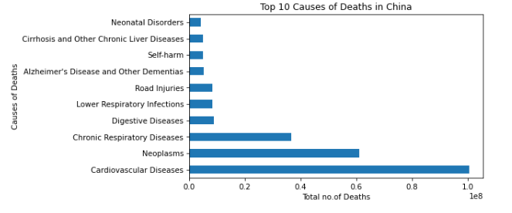
1. For China:
Observation:
There is a clear raise in Total No. of Deaths recorded with each incrementing year for China.
Major Causes of Deaths for China are:
Cardiovascular Diseases
Neoplasms
Chronic Respiratory Diseases
Digestive Diseases
Lower Respiratory Infections
Road Injuries
Deaths in China due to Alzheimer's Disease and Other Dementias is becoming more dominant among all Deaths Caused by Brain related Diseases with every incrementing year.

Slide 10
Deaths in China due to Digestive Diseases is almost constant & Dominant among all Deaths Caused by Gastrointestinal related Diseases with every incrementing year.
Deaths in China due to Chronic Respiratory Diseases is almost constant(between 10.3lakh/year & 13.5lakh/year) & Dominant among all Deaths Caused by Respiratory related Diseases with every incrementing year.
Deaths in China due to Cardiovascular Diseases is most Dominant among all Deaths Caused with every incrementing year.
Deaths in China due to Pregnancy related issues is on decline with every incrementing year.
Deaths in China due to all kidney related Diseases is Dominant with every incrementing year.
Deaths in China due to Cirrhosis and Other Chronic Liver Diseases is Dominant among all Deaths Caused by liver related Diseases with every incrementing year.
Deaths in China due to Natural or Man-made Deaths are summarised below:
Deaths due to 'Interpersonal Violence' is declining with every incrementing year.
Deaths due to 'Drug Use Disorders' is declining with every incrementing year.
Deaths due to 'Self-harm' is declining with every incrementing year.
Deaths due to 'Exposure to Forces of Nature' is highest in 2008 due to the cold spell mortality in subtropical China. The 2008 cold spell increased mortality by 43.8% compared to non-cold spell days with the highest effects in southern and central China.
Deaths due to "Fire, Heat, and Hot Substances" is declining with every incrementing year.
Deaths due to 'Poisonings',is increasing with every incrementing year.
Deaths due to 'Conflict and Terrorism' is negligible when compared to other causes of deaths.
Deaths due to 'Environmental Heat and Cold Exposure' is declining with every incrementing year.
Deaths due to 'Road Injuries' was increased between 1990-2010 & declining thereafter.
Deaths due to 'Drowning' is declining with every incrementing year.

Slide 11
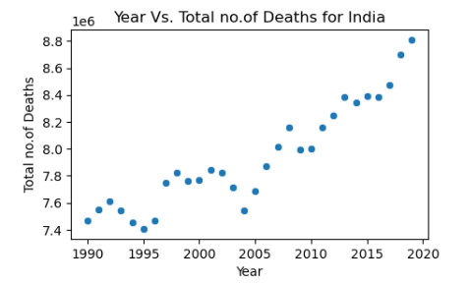
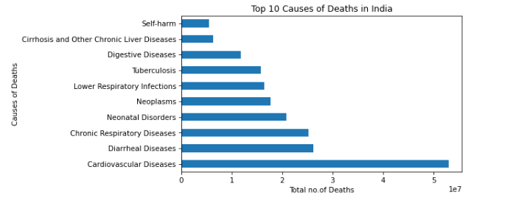
2. For India:
Observation:
We can see slight dips in the total death counts, in India.
Major Causes of Deaths for India are:
Cardiovascular Diseases
Diarrheal Diseases
Chronic Respiratory Diseases
Neonatal Disorders
Neoplasms
Lower Respiratory Infections
Tuberculosis
Deaths in India due to Alzheimer's Disease and Other Dementias is becoming more dominant among all Deaths Caused by Brain related Diseases with every incrementing year.

Slide 12
Deaths in India due to Diarrheal Diseases is dominant among all Deaths Caused by Gastrointestinal related Diseases with every incrementing year.
Deaths in India due to Chronic Respiratory Diseases is dominant among all Deaths Caused by Respiratory related Diseases with every incrementing year.
Deaths in India due to cardiovascular diseases is most Dominant among all Deaths Caused with every incrementing year.
Deaths in India due to Pregnancy related issues is on decline with every incrementing year.
Deaths in India due to all kidney related Diseases is Dominant with every incrementing year.
Deaths in India due to Cirrhosis and Other Chronic Liver Diseases is Dominant among all Deaths Caused by liver related Diseases with every incrementing year.
Deaths in India due to Natural or Man-made Deaths are summarised below:
Deaths due to 'Interpersonal Violence' is constant with every incrementing year.
Deaths due to 'Drug Use Disorders' is incrementing with every incrementing year.
Deaths due to 'Self-harm' is constant with every incrementing year.
Deaths due to 'Exposure to Forces of Nature' is highest in 1993, 2001, 2004 & 2013.
Deaths due to "Fire, Heat, and Hot Substances" is constant with every incrementing year.
Deaths due to 'Poisonings', is declining with every incrementing year.
Deaths due to 'Conflict and Terrorism' is declining with every incrementing year, but need to be taken care of.
Deaths due to 'Environmental Heat and Cold Exposure' is constant with every incrementing year.
Deaths due to 'Road Injuries' is incrementing with every incrementing year.
Deaths due to 'Drowning' is declining with every incrementing year.

Slide 13
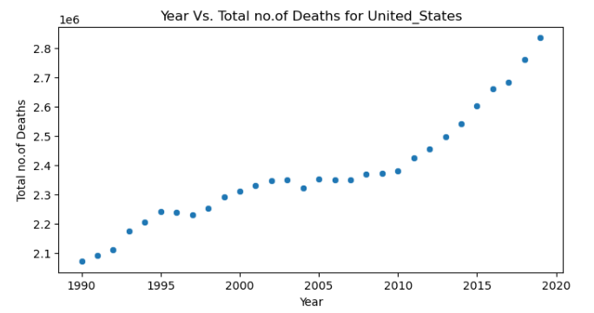
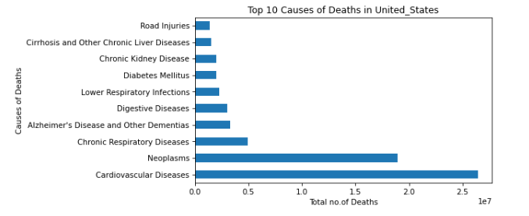
3. For United States of America:
Observation:
There is a clear raise in Total No. of Deaths recorded with each incrementing year, in United States.
Major Causes of Deaths for United States are:
Cardiovascular Diseases
Neoplasms
Chronic Respiratory Diseases
Alzheimer's Disease and Other Dementias
Digestive Diseases
Deaths in United States due to Alzheimer's Disease and Other Dementias is becoming more dominant among all Deaths Caused by Brain related Diseases with every incrementing year.

Slide 14
Deaths in United States due to Digestive Diseases is increasing almost exponentially & is Dominant among all Deaths Caused by Gastrointestinal related Diseases with every incrementing year.
Deaths in United States due to Chronic Respiratory Diseases is increasing & dominant among all Deaths Caused by Respiratory related Diseases with every incrementing year.
Deaths in United States due to cardiovascular diseases is most Dominant among all Deaths Caused with every incrementing year. Also, deaths due to Neoplasms(Cancer) is increasing.
Deaths in United States due to Pregnancy related issues is on decline with every incrementing year.
Deaths in United States due to all kidney related Diseases is Dominant with every incrementing year.
Deaths in United States due to Cirrhosis and Other Chronic Liver Diseases is Dominant among all Deaths Caused by liver related Diseases with every incrementing year.
Deaths in United States due to Natural or Man-made Deaths are summarised below:
Deaths due to 'Interpersonal Violence' is decreasing with every incrementing year.
Deaths due to 'Drug Use Disorders' is incrementing with every incrementing year.
Deaths due to 'Self-harm' is almost constant with every incrementing year.
Deaths due to 'Exposure to Forces of Nature' is highest in 2005.
Deaths due to "Fire, Heat, and Hot Substances" is constant with every incrementing year.
Deaths due to 'Poisonings', is slightly increasing with every incrementing year.
Deaths due to 'Conflict and Terrorism' is declining with every incrementing year, except in 2001 due to WTC Attack.
Deaths due to 'Environmental Heat and Cold Exposure' is constant with every incrementing year.
Deaths due to 'Road Injuries' is slightly decreasing with every incrementing year.
Deaths due to 'Drowning' is slightly declining with every incrementing year.

Slide 15
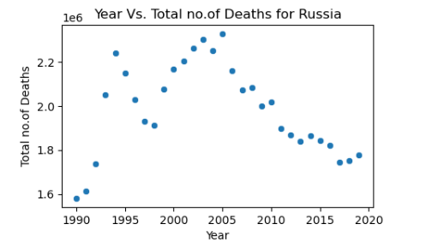
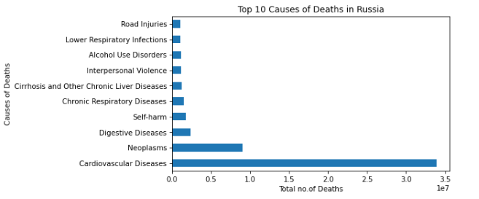
4. For Russia:
Observation:
There is a clear decrease in Total No. of Deaths after 2005 with each incrementing year in Russia.
Major Causes of Deaths for Russia are:
Cardiovascular Diseases
Neoplasms
Digestive Diseases
Self-harm
Chronic Respiratory Diseases
Deaths in Russia due to Alzheimer's Disease and Other Dementias is becoming more dominant among all Deaths Caused by Brain related Diseases with every incrementing year.

Slide 16
Deaths in Russia due to Digestive Diseases is increasing almost exponentially & is Dominant among all Deaths Caused by Gastrointestinal related Diseases with every incrementing year.
Deaths in Russia due to Chronic Respiratory Diseases is decreasing but dominant among all Deaths Caused by Respiratory related Diseases with every incrementing year.
Deaths in Russia due to cardiovascular diseases is most Dominant among all Deaths Caused with every incrementing year.
Deaths in Russia due to Pregnancy related issues is on decline with every incrementing year.
Deaths in Russia due to all kidney related Diseases is Dominant with every incrementing year.
Deaths in Russia due to Cirrhosis and Other Chronic Liver Diseases is Dominant among all Deaths Caused by liver related Diseases with every incrementing year.
Deaths in Russia due to Natural or Man-made Deaths are summarised below:
Deaths due to 'Interpersonal Violence' is decreasing with every incrementing year.
Deaths due to 'Drug Use Disorders' is decreasing with every incrementing year.
In Russia, Deaths due to 'Self-harm' is decreasing with every incrementing year.
Deaths due to 'Exposure to Forces of Nature' is highest in 2002.
Deaths due to "Fire, Heat, and Hot Substances" is decreasing with every incrementing year.
Deaths due to 'Poisonings', is decreasing with every incrementing year.
Deaths due to 'Conflict and Terrorism' is declining with every incrementing year, except in between 1999 & 2002.
Deaths due to 'Environmental Heat and Cold Exposure' is decreasing with every incrementing year.
Deaths due to 'Road Injuries' is decreasing with every incrementing year.
Deaths due to 'Drowning' is declining with every incrementing year.

Slide 17
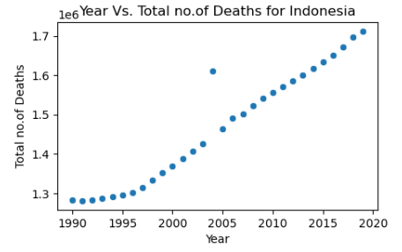
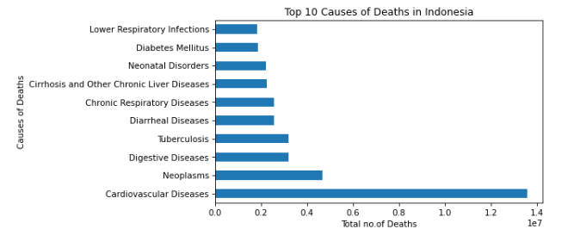
5. For Indonesia:
Observation:
There is a clear raise in Total No. of Deaths recorded with each incrementing year, in Indonesia.
Major Causes of Deaths for Indonesia are:
Cardiovascular Diseases
Neoplasms
Digestive Diseases
Tuberculosis
Diarrheal Diseases
Chronic Respiratory Diseases
Deaths in Indonesia due to Alzheimer's Disease and Other Dementias is becoming more dominant among all Deaths Caused by Brain related Diseases with every incrementing year.

Slide 18
Deaths in Indonesia due to Digestive Diseases is increasing almost linearly & is Dominant among all Deaths Caused by Gastrointestinal related Diseases with every incrementing year.
Deaths in Indonesia due to Chronic Respiratory Diseases is increasing & dominant among all Deaths Caused by Respiratory related Diseases with every incrementing year.
Deaths in Indonesia due to Cardiovascular diseases is most Dominant among all Deaths Caused with every incrementing year. Also, deaths due to HIV/AIDS is increasing almost exponentially.
Deaths in Indonesia due to Pregnancy related issues is on decline with every incrementing year.
Deaths in Indonesia due to all kidney related Diseases is Dominant with every incrementing year.
Deaths in Indonesia due to Cirrhosis and Other Chronic Liver Diseases is Dominant among all Deaths Caused by liver related Diseases with every incrementing year.
Deaths in Indonesia due to Natural or Man-made Deaths are summarised below:
Deaths due to 'Interpersonal Violence' is almost constant with every incrementing year.
Deaths due to 'Drug Use Disorders' is incrementing with every incrementing year.
Deaths due to 'Self-harm' is almost constant with every incrementing year.
Deaths due to 'Exposure to Forces of Nature' is highest in 2004.
Deaths due to "Fire, Heat, and Hot Substances" is constantly declining with every incrementing year.
Deaths due to 'Poisonings', is constant with every incrementing year.
Deaths due to 'Conflict and Terrorism' is negligible with every incrementing year, except between 1999 & 2005.
Deaths due to 'Environmental Heat and Cold Exposure' is constant with every incrementing year.
Deaths due to 'Road Injuries' is slightly decreasing with every incrementing year.
Deaths due to 'Drowning' is declining with every incrementing year.

Slide 19
THANK YOU

